Slide 1
Jenkins
Sahithi S

Slide 2
Ajenda

Slide 3
Continuous Integration:
A development practice in which the developers are required to commit changes to the source code in a shared repository several times a day or more frequently.
Every commit made in the repository is then built.
This allows the teams to detect the problems early.

Slide 4
Functions:
Co-ordinate the running of the tasks as part of workflows.
Compile, test and package and deploy
Get the test results.

Slide 5
Advantages:
t is an open source tool with great community support.
It is easy to install.
It has 1000+ plugins to ease your work. If a plugin does not exist, you can code it and share with the community.
It is free of cost.
It is built with Java and hence, it is portable to all the major platforms.

Slide 6
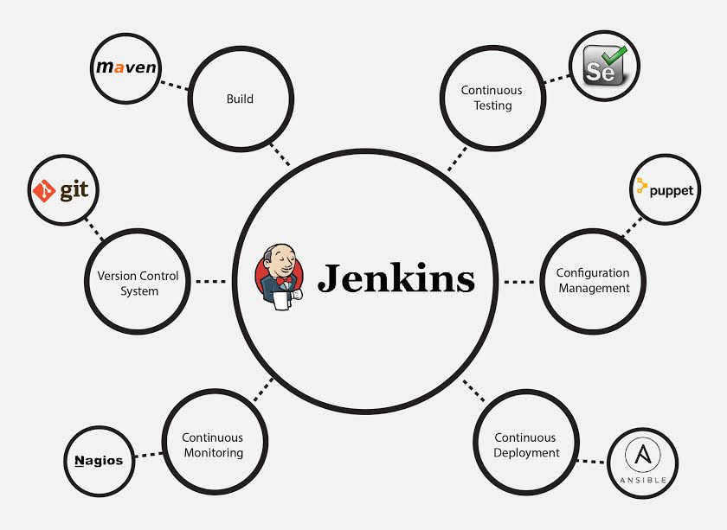
Integration of Jenkins

Slide 7
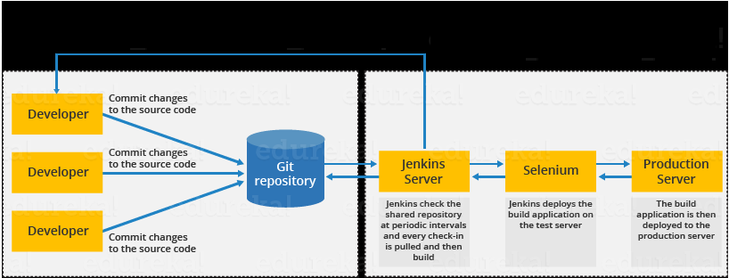
Jenkins Architecture

Slide 8
Jenkins Distributed Architecture
Jenkins uses a Master-Slave architecture to manage distributed builds. In this architecture, Master and Slave communicate through TCP/IP protocol.
Jenkins Master
Your main Jenkins server is the Master. The Master’s job is to handle
Scheduling build jobs.
Dispatching builds to the slaves for the actual execution.

Slide 9
Jenkins Slave
A Slave is a Java executable that runs on a remote machine. Following are the characteristics of Jenkins Slaves
It hears requests from the Jenkins Master instance.
Slaves can run on a variety of operating systems.
The job of a Slave is to do as they are told to, which involves executing build jobs dispatched by the Master.

Slide 10
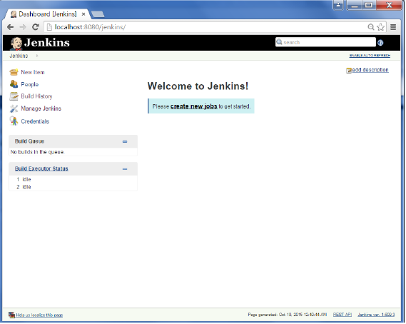
Jenkins-BuildJobs

Slide 11
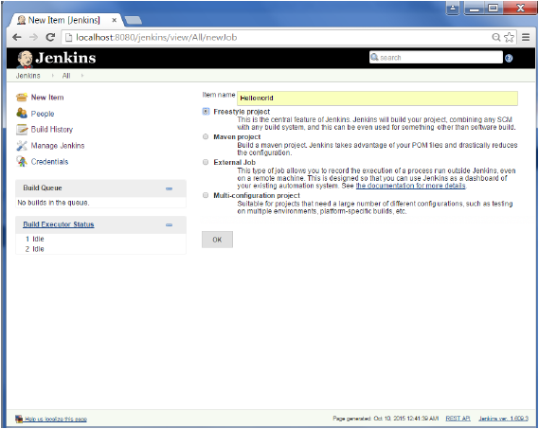
Cont..

Slide 12
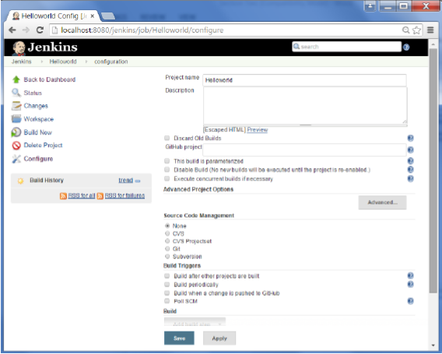

Slide 13
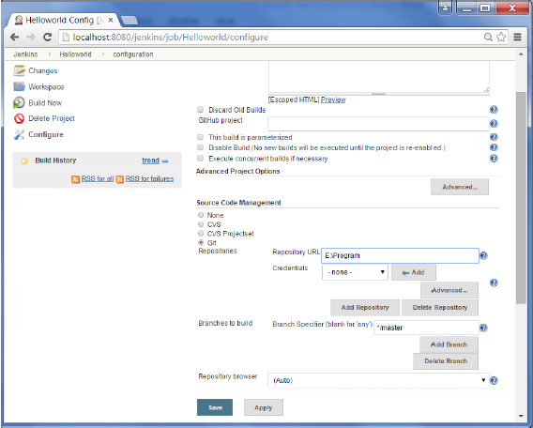

Slide 14
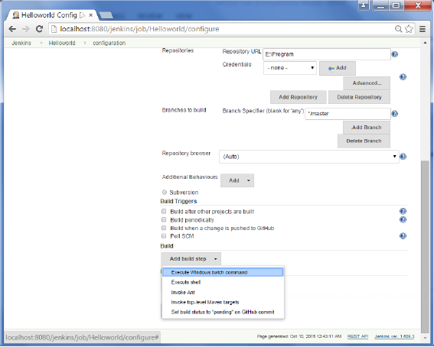

Slide 15
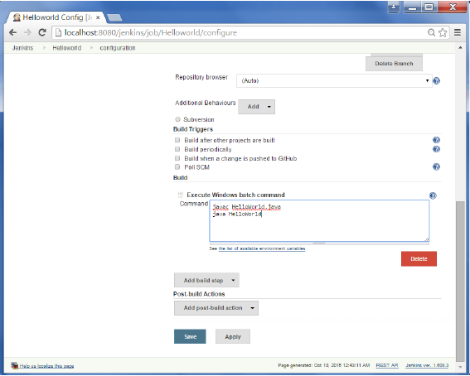

Slide 16
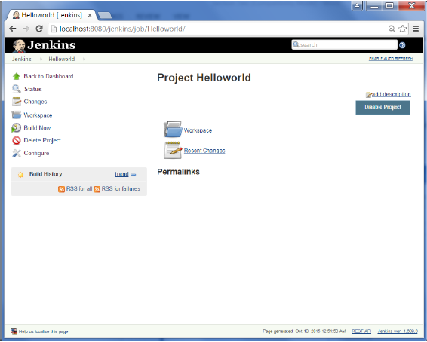
Roles

Slide 17
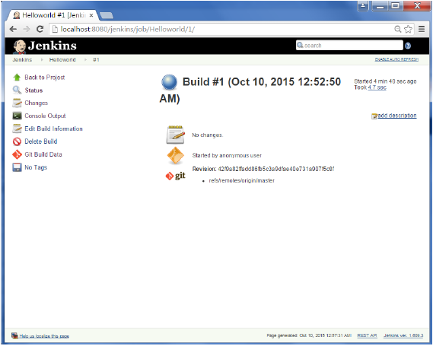
Contribution

Slide 18

Achievements

Slide 19
Thank You

